Slide 1
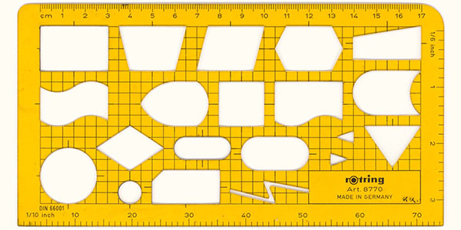
Lesson: 4-6, 9
Introduction to Flowcharts,
Raptor tool and Flowcharts for simple problems

Slide 2
Objectives
To learn the following concepts:
Introduction to flow charts .
Introduction to RAPTOR tool.
Implementing flowchart through RAPTOR tool for simple problems.

Slide 3
Representation of computation
Flow chart and algorithm are used to represent any computational problem.
Flowchart: It is a graphical/pictorial representation of computation
Algorithm: Series of steps to solve a Problem and use English like statements

Slide 4
Key features of flow charts
It is a diagrammatic representation of computation.
It is also defined as a visual or graphical representation of computation.
Using flowcharts it is easy to understand and analyze the problem.
It is an useful aid for programmers and system analysts.
It is machine independent. They can be used for any type of logic.
RAPTOR tool is used for creating flowcharts.
Notes:
4
4

Slide 5
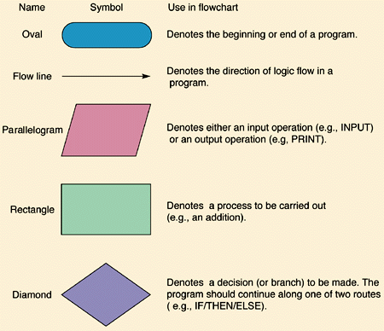
Basic Flowchart Symbols

Slide 6

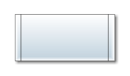
Basic Flowchart Symbols – contd..
Connector Symbol
Indicates that the flow continues where a matching symbol (containing the same letter) has been placed.
Subroutine Symbol
Indicates a sequence of actions that perform a specific task embedded within a larger process. This sequence of actions could be described in more detail on a separate flowchart.

Slide 7
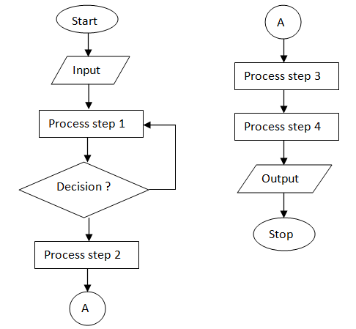
Basic Flowchart

Slide 8
RAPTOR
RAPTOR , the Rapid Algorithmic Prototyping Tool for Ordered Reasoning, is a tool used for drawing and executing flowcharts.
The RAPTOR development environment minimizes the amount of syntax so that leaner can focus on the solution steps,
Notes:
Additional notes on RAPTOR
RAPTOR is a flowchart-based programming environment, designed specifically to help students visualize their algorithms and avoid syntactic baggage. RAPTOR programs are created visually and executed visually by tracing the execution through the flowchart.
We use RAPTOR for several reasons.
1. The RAPTOR development environment minimizes the amount of syntax you must learn to write correct program instructions.
2. The RAPTOR development environment is visual.
3. RAPTOR programs are diagrams (directed graphs) that can be executed one symbol at a time. This will help you follow the flow of instruction execution in RAPTOR programs.
4. RAPTOR is designed for ease of use.
5. RAPTOR error messages are designed to be more readily understandable by beginning programmers.

Slide 9



Symbols used in RAPTOR
 | The assignment symbol is used to change the value of a variable. The right hand side of the assignment is evaluated, and the resulting value is placed in the variable on the left hand side. For example, consider the case where the value of x is currently 5, and the assignment "x <- x + 1" is executed. First "x+1" is evaluated, yielding the result 6. Then the value of x is changed to be 6. Note that assignment is very different from mathematical equality. The statement should be read "Set x to x+1" instead of "x equals x+1".
 | The call symbol is used to invoke procedures such as graphics routines and other instructor-provided procedures. The call symbol is also used to run subcharts included in a Raptor program.
 | The input symbol is used to ask the user for a number or string while the flowchart is executing. When an input symbol is executed, the user will be prompted with a dialog to enter a value that can be interpreted as either a number or string, depending on what the user types.

Slide 10



Symbols used in RAPTOR
 | The output symbol is used to either write a number or text to the Master Console window.
 | The selection structure is used for decision making. The programmer enters in the diamond an expression that evaluates to Yes (True) or No (False). Such expressions are formally referred to as Boolean expressions. Based on the result of the expression in the diamond, control of the program will branch either left (Yes, or True) or right (No, or False).
 | The loop structure is used to repeat a sequence of symbols until a certain condition is met. When execution reaches the bottom of the loop, it starts over again at the top. The loop is exited when the diamond symbol is executed and the Boolean expression in the diamond evaluates to Yes (True).

Slide 11
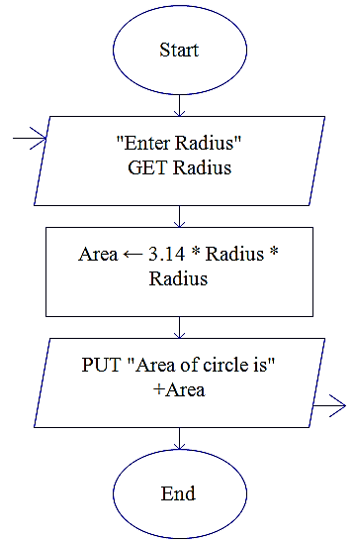
Algorithm and Flowchart for area of the circle
Name of the algorithm : Compute the area of a circle
Step1: [Input the value for radius]
Input radius
Step 2: [Compute the area]
Area ← 3.1416 * radius * radius
Step 3: [Print the Area]
Print ‘Area of a circle =‘, Area
Step 4: [End of algorithm]
Stop
AreaC

Slide 12
Algorithm for SI and CI
Name of the algorithm: Calculate SI and CI
Step1: [ Read the values of P, T and R]
Input P,R,T
Step 2: [Compute the simple interest]
SI ← ( P*R*T)/100
Step 3: [Compute the compound interest]
CI ← P*(1+ R/100)^{T} -P
Step 4: [Print the simple and compound interest]
Print ‘Simple Interest=‘,SI
Print ‘Compound Interest=‘,CI
Step 5: [End of Algorithm]
Stop
Notes:
12
12

Slide 13
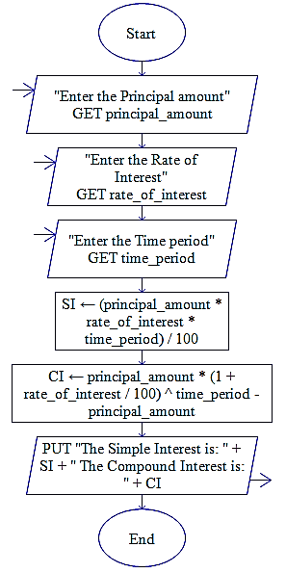
Flowchart for SI and CI
Notes:
13
13

Slide 14
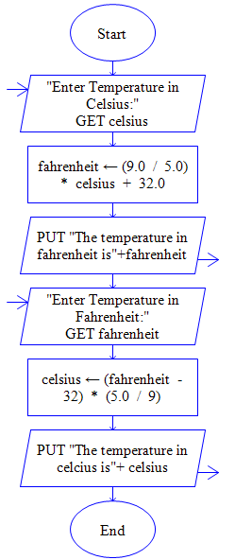
To convert Celsius to Fahrenheit & vice versa

Slide 15
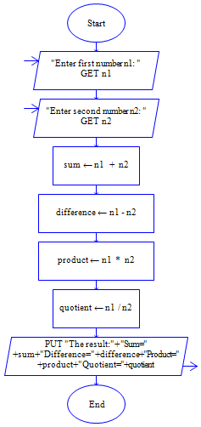
Flowchart for arithmetic operations

Slide 16
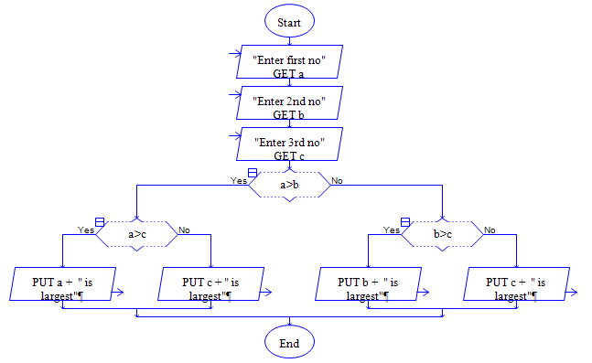
Largest of 3 Numbers contd.

Slide 17
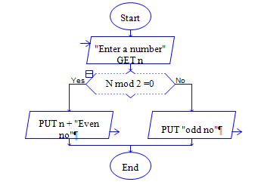
Check whether the given no. is even or odd

Slide 18
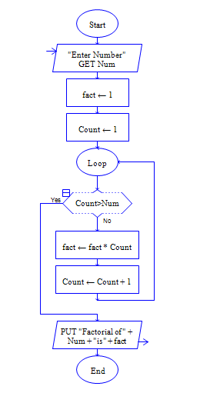
Flowchart to find factorial of given no
Notes:
Factorial computing
Factorials are very simple things. They're just products, indicated by an exclamation mark. For instance, "four factorial" is written as "4!" and means 1×2×3×4 = 24. In general, n! ("enn factorial") means the product of all the whole numbers from 1 to n; that is, n! = 1×2×3×...×n.

Slide 19
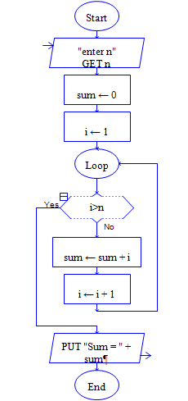
Flowchart to find sum of natural numbers

Slide 20
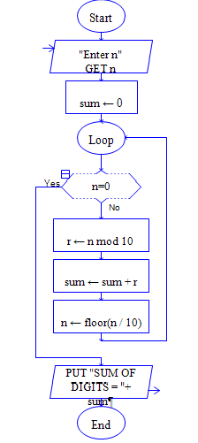
Flowchart to find sum of digits of a given no
Notes:
Additional notes on FLOOR
The floor functions return the largest integral value less than or equal to x.
For example
Floor of 12.5 is 12.0; floor of 12.6 is also 12.0.

Slide 21
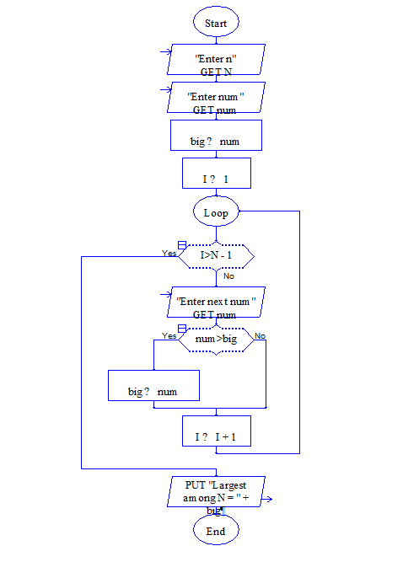
Largest among n numbers

Slide 22
Summary
Introduction to Flowcharts .
Introduction to RAPTOR tool.
Implementing flowchart through RAPTOR tool for simple problems.

